Slide 1
iPhone versus Samsung
Which Phone Receives Messages Faster?
By: Cameron Hobbs (30052888), Justin Marquez (30037615), Jana Osea (30016679)
STAT 425 - Statistical Design and Analysis of Experiments
University of Calgary
Notes:
Justin

Slide 2
Outline
Motivation
Design
Diagnostics and Data Transformation
Analysis
Global Hypothesis
Secondary Hypotheses
Multiple Comparison
Conclusion
Notes:
Jana

Slide 3
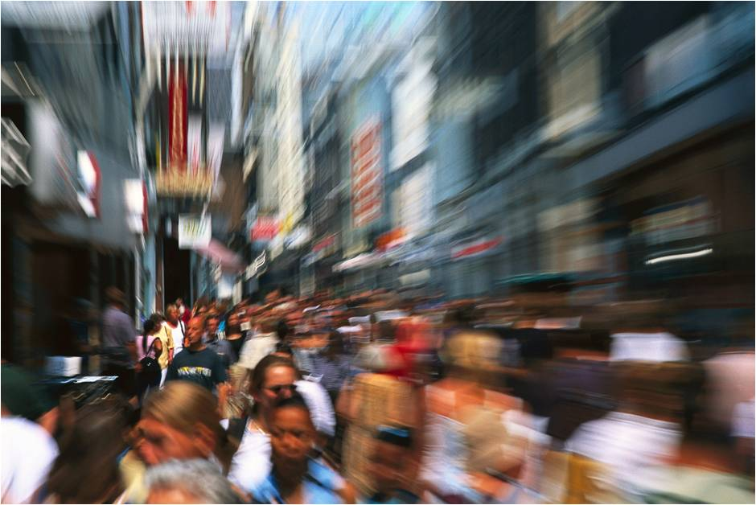
Motivation
https://udaya.com/eating-well-on-a-fast-paced-lifestyle/
Notes:
Jana
Technology has advanced exponentially in the past few decades. Technology has brought so much convenience into people’s lives which allows people to accomplish a lot more in their day. Because of this, society functions at a relatively higher pace than in any time in the past.

Slide 4

Motivation
https://giphy.com/gifs/reactiongifs-mrw-qRhkPuV1PZoC4
Notes:
Jana
Such a high paced society causes people to seek out technology that would save even seconds of their time. Slowly but surely, we all become prey to being impatient when slight inconveniences come our way.

Slide 5
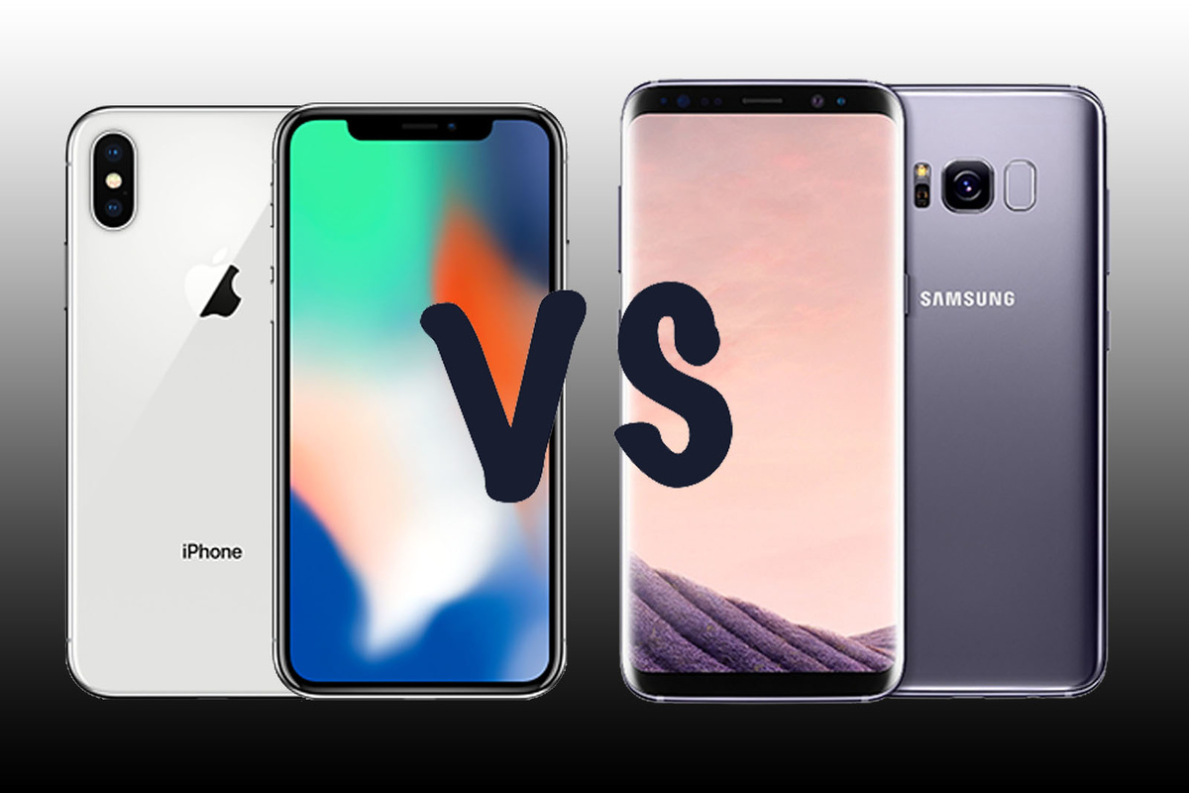
Motivation
https://www.pocket-lint.com/phones/buyers-guides/142239-apple-iphone-x-vs-samsung-galaxy-s8-pistols-at-dawn-for-the-ultimate-face-off
Notes:
Jana
For example, we all have been in a situation where we are waiting for a message to be sent or vice versa. This is why decided to create an experiment dedicated to determining which phone brand receives messages faster particularly we chose to compare two extremely popular brands--the Apple iPhone and Samsung S9+.
We hope that through this experiment, we can determine which phone brand can save even a few seconds of your time so that … (switch slides)

Slide 6
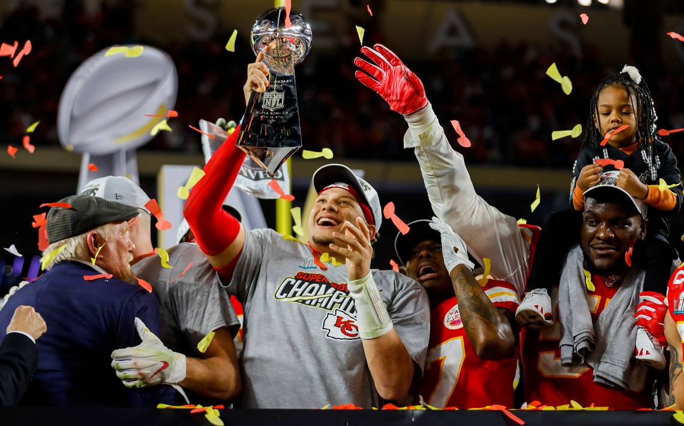
Motivation
https://clutchpoints.com/chiefs-video-kansas-citys-super-bowl-celebration-could-be-seen-on-radar/
Notes:
Jana
… you can go back to the things that you really “enjoy”.

Slide 7
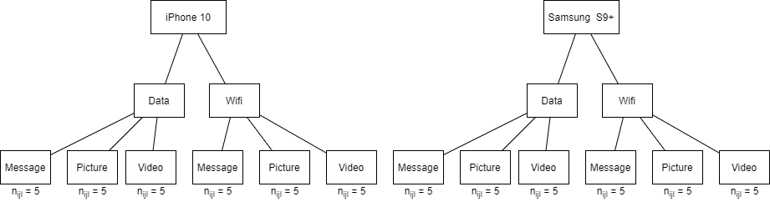
Design
Response variable: The time in seconds for the phone to receive a given message
Note: All three factors are at fixed levels
Notes:
Cam
For this experiment, we chose to implement a three stage nested design. As a group we identified three important factors involved in receiving a message, the phone, the connection, and the type of message. The first factor here will be the phone brand (“brand effect”), as the nested design allows to compare across the k levels of factor A, in this case, samsung s9+ and iphone 10. For the second factor, we felt it was important to test if there is a significant difference between the phone connected to either data or wifi, which is nested within each phone brand (“connection effect”). Lastly for the third factor, we chose the three main types of messages most commonly sent which are, regular texts, pictures, and videos (“message effect”). Each combination has 5 data points. Note in this experiment….. (read slides)

Slide 8
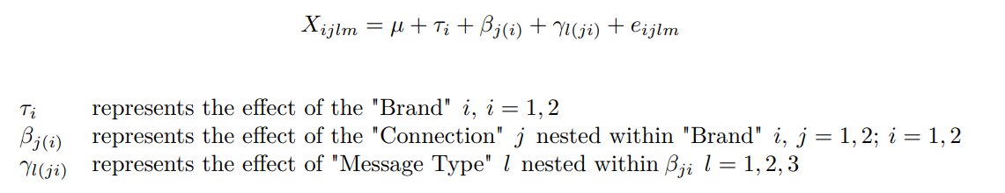
Design (cont’d)
Response variable: The time in seconds for the phone to receive a given message
Note: All three factors are at fixed levels
Notes:
Cam
Here is our model as seen in lecture, … (read off slides)….
As you can see, there is no two-way or three-way interaction terms in this model. This is the reason we chose to do the nested design, as the main goal of this experiment is to test which phone brand is faster at receiving messages. So, we wanted to avoid any potential interaction effect that might have prevented us from testing if there is indeed a factor A / “phone brand effect”

Slide 9
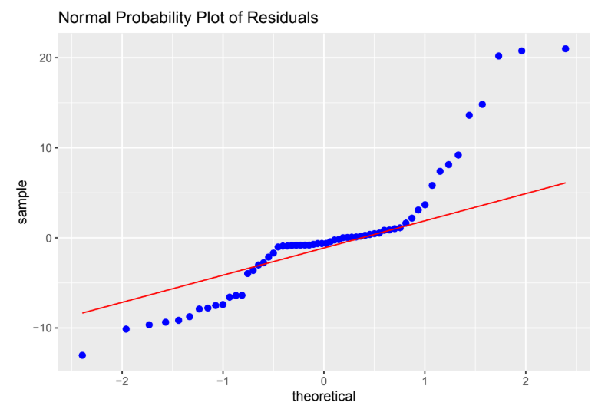
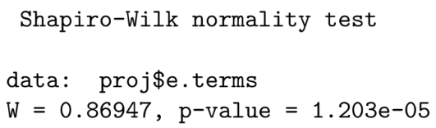
Diagnostics and Data Transformation
Not Normally distributed
Variance Stabilization needed
Notes:
It appears that the residual plot is not Normally distributed and this is further supported by a Shapiro-Wilk normality test with a p-value of of 0.000012. Thus need to perform a variance stabilization transformation.

Slide 10
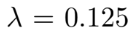
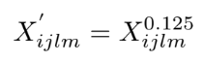
Diagnostics and Data Transformation

Slide 11
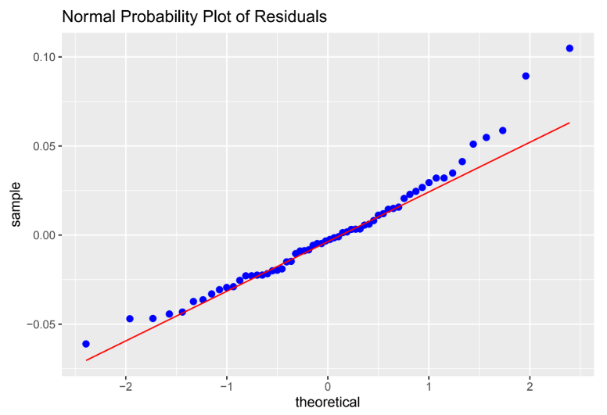
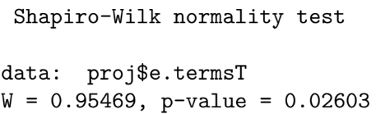
Diagnostics and Data Transformation
More Normally distributed
Notes:
After performing multiple transformations, we have found that the best lambda is λ = 0.125 which is the 8th root which results in the following residual plot and Shapiro-Wilk normality test.
Although this p-value is still less than 0.05, this is the best p-value we were able to obtain so throughout the the rest of the analysis, we will be using the transformed data.

Slide 12
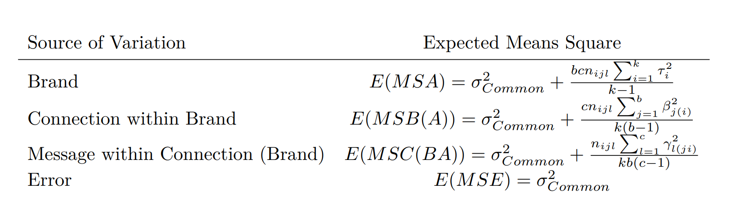
Analysis
Test Statistics
Notes:
Cam
Discuss why tests stats are all divided by MSE because tests are under the assumption that the null hypothesis is true

Slide 13
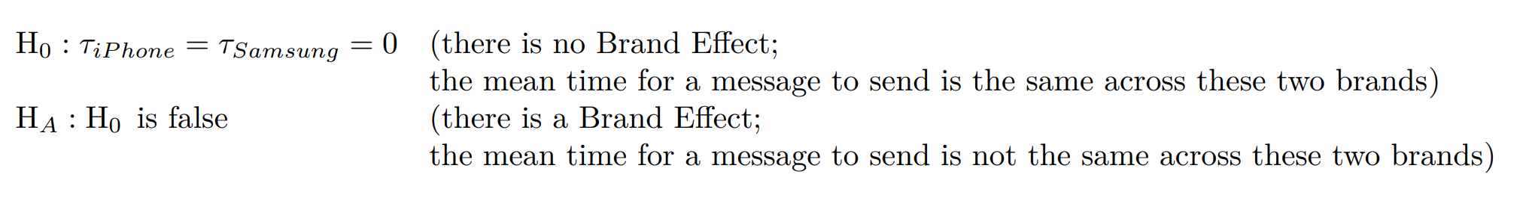
Analysis
Global Hypothesis
Notes:
Jana

Slide 14
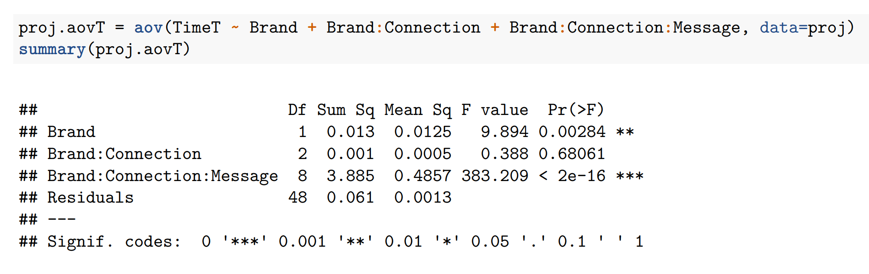
Analysis
Global Hypothesis
Notes:
Jana

Slide 15
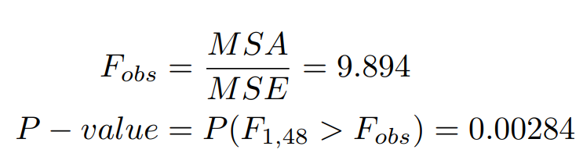
Analysis
Global Hypothesis
There is a Brand Effect!
Notes:
Jana

Slide 16
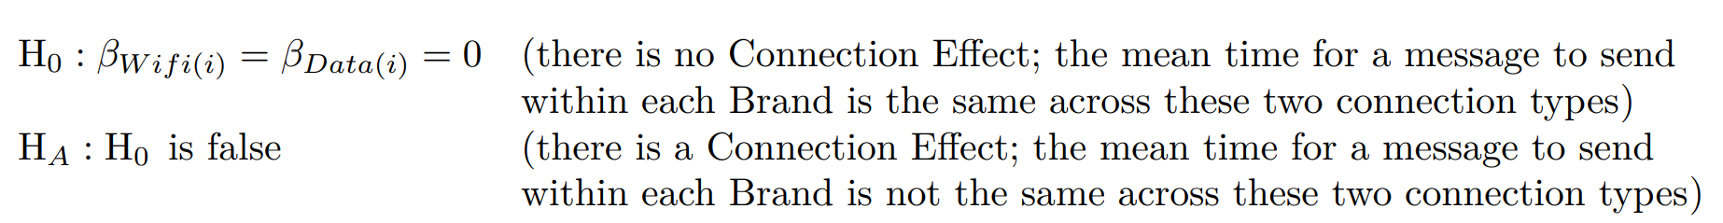
Analysis
Secondary Hypothesis
Notes:
Cam
Discuss hypothesis

Slide 17
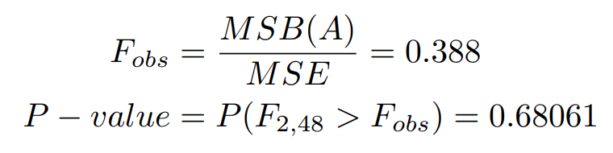
Analysis
Secondary Hypothesis
There is no Connection Effect nested within iPhone and Samsung
Notes:
Cam
Based on the data we found...

Slide 18
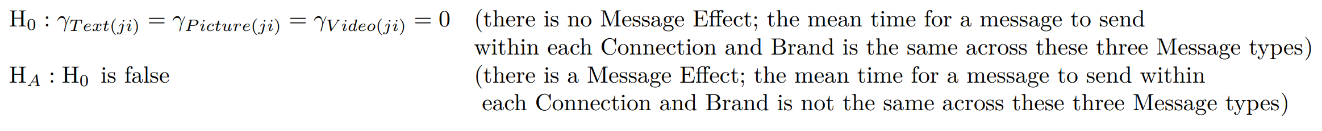
Analysis
Tertiary Hypothesis
Notes:
Jana

Slide 19
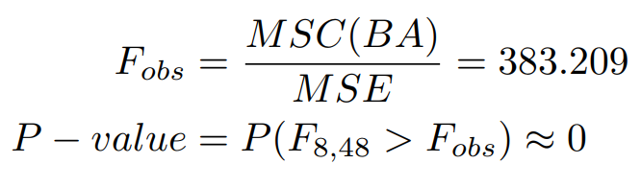
Analysis
Tertiary Hypothesis
There is a Message Effect nested within Connection and Brand!
Notes:
Jana

Slide 20
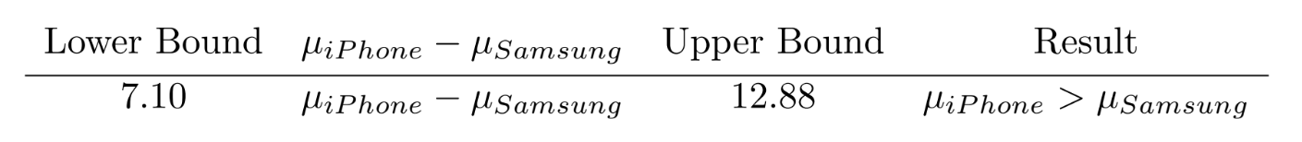
Analysis
Multiple Comparisons(Brand)
On average, iPhones take longer to receive messages
Notes:
We have found that there is a Brand Effect therefore we will perform a Bonferroni
Bonferroni multiple comparison method to obtain a family wise 95% confidence interval.
So on average, iPhones take between 7.10s to 12.88s longer for messages to be received compared to Samsung.

Slide 21
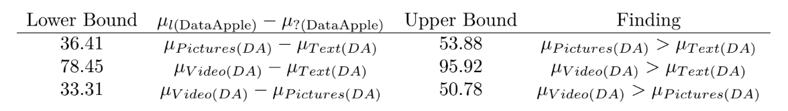
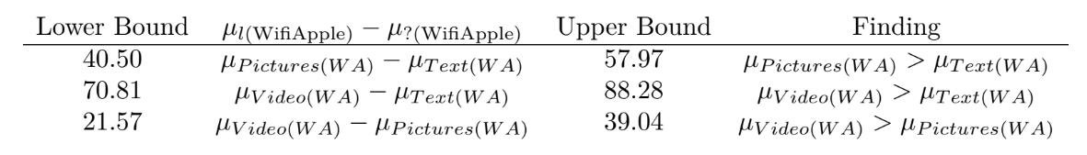
Analysis
Multiple Comparisons (Message)

Slide 22
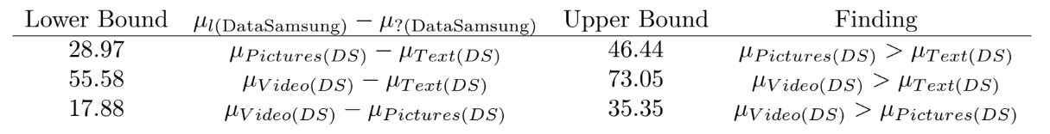
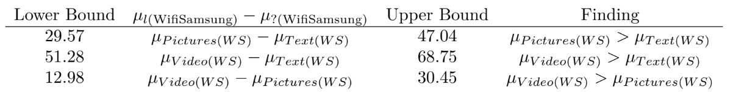
Analysis
Multiple Comparisons (Message)

Slide 23
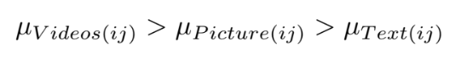
Analysis
Multiple Comparisons (Message)
Notes:
Video Messages took the most amount of time while Text Messages took the least amount of time and Picture Messages in between.

Slide 24
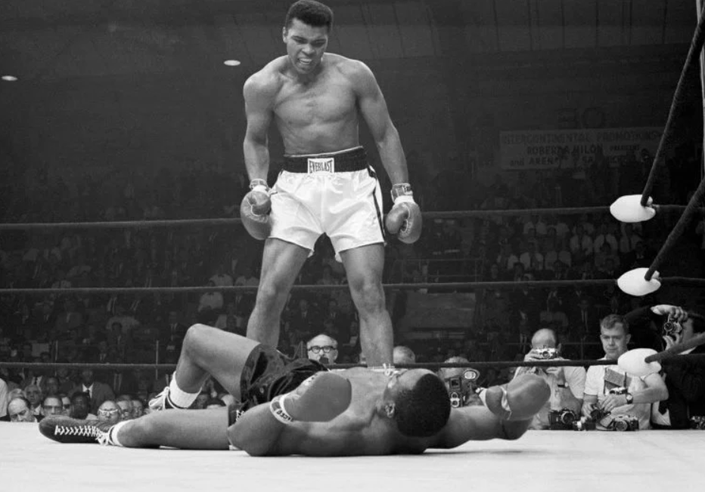
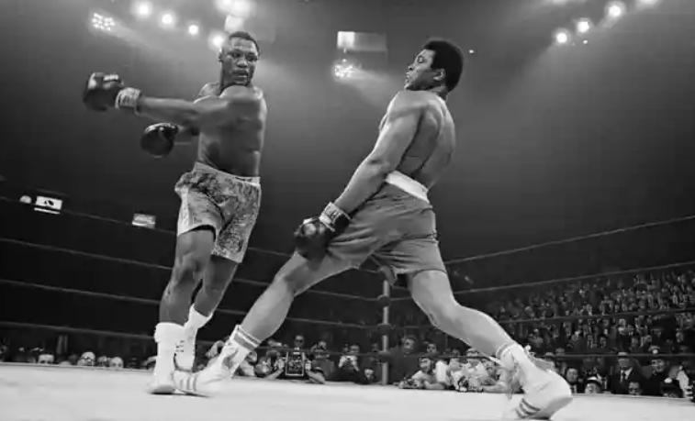
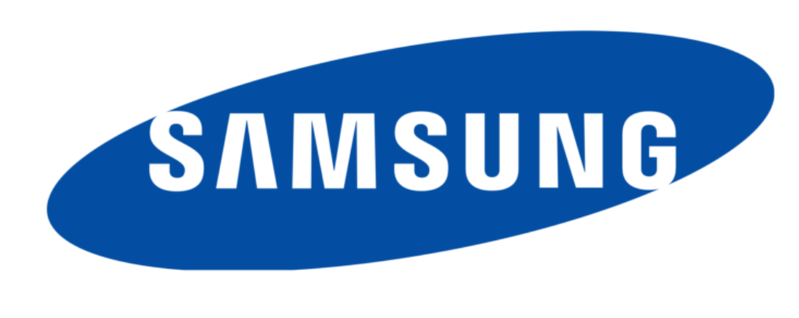

Conclusion
Notes:
In conclusion, based on the data for the Three-Stage Nested Design, a Brand Effect was found. The difference between the mean time in seconds in which an iPhone 10 and Samsung S9+ smartphone received a message was between 7.10 and 12.88 seconds. Therefore, we can say that a Samsung S9+ smartphone is faster at receiving messages than an iPhone 10.
We also found that there is no Connection Effect which means the average time for a message to be received was the same across Wifi and Data within Apple and Samsung.
Lastly, there is a Message effect within each Connection and Brand and so the average time for a message to be received was not the same across Text, Picture and Video within each Connection and Brand. Specifically, the multiple comparison method showed…… (see future code)

